Slide 1
Photography
Unit 4 – Composition & Principles of Design

Slide 2
Unit 4 – Composition & Design Principles
Section 1 – Composition

Slide 3
The big idea
Learn about the elements of art
Learn about the principles of design
How to use the elements and principles to make photographs

Slide 4
Google Classroom Code
Photography
rhxkpt
Photography
7mdo2ur

Slide 5
Elements and Principles
Elements
Line
Shape and Form
Color
Primary
Secondary
Value
Space
Texture
Principles
Pattern
Balance
Rules of Thirds
Unity and Variety
Movement and Rhythm
Emphasis
Proportion

Slide 6
Elements LINE
The most fundamental art element
Can serve as pathways to draw attention to a particular point
Create boundaries
Separate and/or differentiate

Slide 7


Slide 8
Elements Shape and Form
Shapes can be geometric or organic
Circles, ovals, triangles, rectangles
Wheels, road signs, windows are common examples
Organic examples could be clouds, puddles, footprints

Slide 9


Slide 10
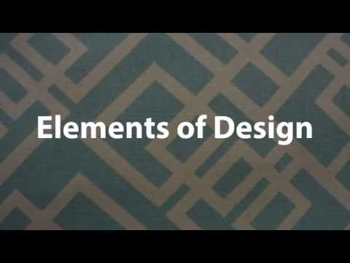
Elements of Art (Video)

Slide 11
LP 3

Slide 12
The big idea
Learn about the elements of art
Learn about the principles of design
How to use the elements and principles to make photographs

Slide 13
Elements and Principles
Elements
Line
Shape and Form
Color
Primary
Secondary
Value
Space
Texture
Principles
Pattern
Balance
Rules of Thirds
Unity and Variety
Movement and Rhythm
Emphasis
Proportion

Slide 14
Elements
Elements
Line
Shape and Form
Color
Value
Space
Texture

